Slide 1
Given the tools
Mike |SCM | June 17, 2018
Notes:
Last week
God does not call the qualified, He qualifies the called.
Excuses – game examples – something unexpected come, will you come back?
Moses
knew it was God telling him to do it
(2) he understood what the job was but still the excuses continued to flow.

Slide 2
Continuation of Moses’ conversation with God….
In Exodus 4:1-17
1Moses answered, “What if they do not believe me or listen to me and say, ‘The Lord did not appear to you’?”
2Then the Lord said to him, “What is that in your hand?”
MOSES protested with reluctance and fear caused by over-anticipation.
2Then the Lord said to him, “What is that in your hand?”
“A staff,” he replied.
3The Lord said, “Throw it on the ground.”
Notes:
1Moses answered, “What if they do not believe me or listen to me and say, ‘The Lord did not appear to you’?”
2Then the Lord said to him, “What is that in your hand?”
“A staff,” he replied.
3The Lord said, “Throw it on the ground.”
Moses threw it on the ground and it became a snake, and he ran from it. 4Then the Lord said to him, “Reach out your hand and take it by the tail.” So Moses reached out and took hold of the snake and it turned back into a staff in his hand. 5“This,” said the Lord, “is so that they may believe that the Lord, the God of their fathers—the God of Abraham, the God of Isaac and the God of Jacob—has appeared to you.”
6Then the Lord said, “Put your hand inside your cloak.” So Moses put his hand into his cloak, and when he took it out, the skin was leprousª —it had become as white as snow.
7“Now put it back into your cloak,” he said. So Moses put his hand back into his cloak, and when he took it out, it was restored, like the rest of his flesh.
8Then the Lord said, “If they do not believe you or pay attention to the first sign, they may believe the second. 9But if they do not believe these two signs or listen to you, take some water from the Nile and pour it on the dry ground. The water you take from the river will become blood on the ground.”
10Moses said to the Lord, “Pardon your servant, Lord. I have never been eloquent, neither in the past nor since you have spoken to your servant. I am slow of speech and tongue.”
11The Lord said to him, “Who gave human beings their mouths? Who makes them deaf or mute? Who gives them sight or makes them blind? Is it not I, the Lord? 12Now go; I will help you speak and will teach you what to say.”
13But Moses said, “Pardon your servant, Lord. Please send someone else.”
14Then the Lord’s anger burned against Moses and he said, “What about your brother, Aaron the Levite? I know he can speak well. He is already on his way to meet you, and he will be glad to see you. 15You shall speak to him and put words in his mouth; I will help both of you speak and will teach you what to do. 16He will speak to the people for you, and it will be as if he were your mouth and as if you were God to him. 17But take this staff in your hand so you can perform the signs with it.”
----
27The Lord said to Aaron, “Go into the wilderness to meet Moses.” So he met Moses at the mountain of God and kissed him. 28Then Moses told Aaron everything the Lord had sent him to say, and also about all the signs he had commanded him to perform.
29Moses and Aaron brought together all the elders of the Israelites, 30and Aaron told them everything the Lord had said to Moses. He also performed the signs before the people, 31and they believed. And when they heard that the Lord was concerned about them and had seen their misery, they bowed down and worshiped.

Slide 3
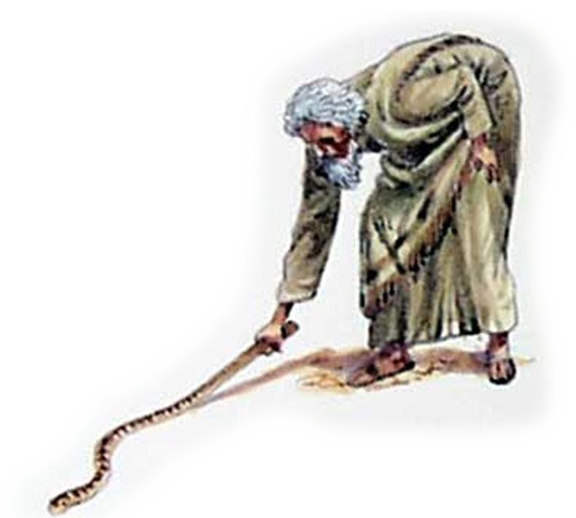
The Staff of Moses
3The Lord said, “Throw it on the ground.”
Moses threw it on the ground and it became a snake, and he ran from it. 4Then the Lord said to him, “Reach out your hand and take it by the tail.” So Moses reached out and took hold of the snake and it turned back into a staff in his hand. 5“This,” said the Lord, “is so that they may believe that the Lord, the God of their fathers—the God of Abraham, the God of Isaac and the God of Jacob—has appeared to you.”
The staff represented Moses' calling in life as a shepherd. It was his vocation
God id transforming his view of his staff - his vocation. No longer was it something to be viewed as a source for money. It was now representative of power and authority from God.
Notes:
1Moses answered, “What if they do not believe me or listen to me and say, ‘The Lord did not appear to you’?”
2Then the Lord said to him, “What is that in your hand?”
“A staff,” he replied.
3The Lord said, “Throw it on the ground.”
Moses threw it on the ground and it became a snake, and he ran from it. 4Then the Lord said to him, “Reach out your hand and take it by the tail.” So Moses reached out and took hold of the snake and it turned back into a staff in his hand. 5“This,” said the Lord, “is so that they may believe that the Lord, the God of their fathers—the God of Abraham, the God of Isaac and the God of Jacob—has appeared to you.”
Moses was about his normal routine of tending the sheep in the fields. He is eighty-years old now.
I am sure he must have had many reflective days thinking about his days in Egypt. He recalled living in Pharoah's palace. He recalled the education he received and the royal treatment he once experienced. I am sure he thought about the beautiful women he saw in the palace.
But there was one memory he would love to forget; the man he killed forty years earlier, thinking this act was going to free his people who were enslaved by Egypt. Now, forty years later, he is living out his days as a shepherd in the hills. The last thing on his mind is a new adventure. He's ready to collect his pension, his past life only a memory.
---
But take this staff in your hand so you can perform miraculous signs with it."(Exodus 4:17) A few verses later, we discover Moses' staff is no longer his staff, but it is the "staff of God." So Moses took his wife and sons, put them on a donkey and started back to Egypt. And he took the staff of Godin his hand (Exodus 4:20).
--
First, the staff represented Moses' calling in life as a shepherd. It was his vocation. God said, "I am going to take your vocation and perform miracles through it" (paraphrase). He changed Moses' paradigm about the way he looked at his staff.
The wood had a creosote-type substance added to it to insure its hardness, giving it a long life. Also, the staff in the pastor's office had marks up and down it. These marks represented dates in which something significant happened in the life of that person. It was like a personal diary, if you will.
This is why the staff of Moses was more than a simple shepherd's staff. That staff represented his work and his very life. It was a very personal tool. Sure, he kept sheep in line with it. He probably killed a few snakes with it. He even leaned on it overlooking the hillside. But, most importantly, it represented his life.
The word staff, which comes from the Hebrew word, "Matteh" is mentioned 250 times in the Old Testament. It equates to spiritual power.

Slide 4
God asked Moses to
Lay it down
The people of God have seen their staffs as mere instruments for accessing finances
God desires to use our staff (vocation) to transform the very cities of our nations into places of freedom and love.
Using the Staff to Gain Provision
Moses used the staff to strike the rock to have water. God will use our staff to provide for people
Using the Rod of God as our Protector
Offer up our work lives to the Lord and see His protection and blessing upon it.
Notes:
The giving up of his shepherd-life would expose him to dangers, from which he would desire to escape. At the same time, there was more implied in the figure of a serpent than danger, which merely threatened his life.
The serpent had been the constant enemy of the seed of the woman (Gen 3), and represented the power of the wicked one, which prevailed in Egypt. But at the bidding of God, Moses seized the serpent by the tail, and received his staff again as 'the rod of God,' with which he smote Egypt with great plagues. From this sign the people of Israel would necessarily perceive, that Jehovah had not only called Moses to be the leader of Israel, but had endowed him with the power to overcome the serpent-like cunning and the might of Egypt; in other words, they would believe that Jehovah, the God of the fathers, had appeared to him." [i]
Moses' staff would be the instrument of transformation for the people of God. It would transform a people from slavery to freedom. It would be used to demonstrate Moses' authority given to him by God.
God is calling forth a people today to see their staff's as instruments of transformation. The people of God have seen their staffs as mere instruments for accessing finances. He is now changing our paradigm. Our staffs represent much more. They are instruments that He desires to use to transform the very cities of our nations into places of freedom and love.
As Moses cried out to the Lord He told him to use his staff to bring water out of the rock. Notice here that he told him to strike the rock. God used his staff to provide for the people.
The LORD answered Moses, "Walk on ahead of the people. Take with you some of the elders of Israel and take in your hand the staff with which you struck the Nile, and go. I will stand there before you by the rock at Horeb. Strike the rock, and water will come out of it for the people to drink." So Moses did this in the sight of the elders of Israel. And he called the place Massah and Meribah because the Israelites quarreled and because they tested the LORD saying, "Is the LORD among us or not?" Ex 17:5-7
The Amalekites came and attacked the Israelites at Rephidim. Moses said to Joshua, "Choose some of our men and go out to fight the Amalekites. Tomorrow I will stand on top of the hill with the staff of God in my hands." Ex 17:,9

Slide 5
6Then the Lord said, “Put your hand inside your cloak.” So Moses put his hand into his cloak, and when he took it out, the skin was leprousª —it had become as white as snow.
7“Now put it back into your cloak,” he said. So Moses put his hand back into his cloak, and when he took it out, it was restored, like the rest of his flesh.
8Then the Lord said, “If they do not believe you or pay attention to the first sign, they may believe the second. 9But if they do not believe these two signs or listen to you, take some water from the Nile and pour it on the dry ground. The water you take from the river will become blood on the ground.”
Notes:
6Then the Lord said, “Put your hand inside your cloak.” So Moses put his hand into his cloak, and when he took it out, the skin was leprousª —it had become as white as snow.
7“Now put it back into your cloak,” he said. So Moses put his hand back into his cloak, and when he took it out, it was restored, like the rest of his flesh.
8Then the Lord said, “If they do not believe you or pay attention to the first sign, they may believe the second. 9But if they do not believe these two signs or listen to you, take some water from the Nile and pour it on the dry ground. The water you take from the river will become blood on the ground.”

Slide 6
10Moses said to the Lord, “Pardon your servant, Lord. I have never been eloquent, neither in the past nor since you have spoken to your servant. I am slow of speech and tongue.”
11The Lord said to him, “Who gave human beings their mouths? Who makes them deaf or mute? Who gives them sight or makes them blind? Is it not I, the Lord? 12Now go; I will help you speak and will teach you what to say.”
13But Moses said, “Pardon your servant, Lord. Please send someone else.”
14Then the Lord’s anger burned against Moses and he said, “What about your brother, Aaron the Levite? I know he can speak well. He is already on his way to meet you, and he will be glad to see you.
Notes:
10Moses said to the Lord, “Pardon your servant, Lord. I have never been eloquent, neither in the past nor since you have spoken to your servant. I am slow of speech and tongue.”
13But Moses said, “Pardon your servant, Lord. Please send someone else.”
14Then the Lord’s anger burned against Moses and he said, “What about your brother, Aaron the Levite? I know he can speak well. He is already on his way to meet you, and he will be glad to see you. 15You shall speak to him and put words in his mouth; I will help both of you speak and will teach you what to do. 16He will speak to the people for you, and it will be as if he were your mouth and as if you were God to him. 17But take this staff in your hand so you can perform the signs with it.”
In many ways Moses was one of the greatest leaders we find in the OT. But he was far from perfect. He made mistakes, he got angry, he was impatient, he committed murder and as a result of his anger and his disobedience Moses missed the Promised Land. God said to Moses because you and Aaron didn’t trust in me enough and didn’t do what I told you to do, you will not be able to enter the Promised Land. You see, trust and obedience go hand in hand. There comes a time when we have to let go of all of our excuses and just say here I am Lord.
.
We see this in the parable of the talents. A wealthy man calls
10 of his servants and gives them all an equal sum of money. When he returned, he calls them together and he said, now tell me what you did with what I gave you. The first one earned ten more. So he puts him in charge of ten cities. The 2nd one earned 5 more so he places him in charge of 5 cities. The 3rd one says I kept it laid away in a piece of cloth----in other words, I laid it down. The Lord then takes it away and gives it to the one who already had 10. Can you imagine his response? Lord, why does he need more? How come he gets everything? Luke 19:26. Use it or lose it.

Slide 7
Just like Moses, we all make mistakes
We run before we are sent.
We retreat after we have failed.
We resist when we are called
Notes:
We run before we are sent. When Moses was younger that’s exactly what he did. God hadn’t sent him yet but he ran on ahead. Sometimes we just can’t wait for God to set thing up. We get impatient so we take action. We run ahead before we’re supposed to.
(2) We retreat after we have failed. If you run before you’re sent you will fail. You’ll fall into a ditch. And when that happens, a lot of us decide that it’s time to just go and hide. Because we’re insecure. We can’t stand the thought of failure. Listen whoever said that we have to succeed at everything we do? That kind of standard is set up by men not God.
(3) We resist when we are called. If you are going to have a heart that beats like HIS then you must practice obedience. Obedience is submission to authority and throughout scripture God demands it. You see, whether you realize it or not, God has the amazing ability to see right through us---He knows your every thought. He knows your heart.
Perhaps you remember the story in the gospels when Jesus was teaching and some men came and brought a man who was paralyzed on a mat --- they tried to get the man through the crowd that was listening to Jesus but they couldn’t so they took him to the roof and lowered him down from the top. Because of their faith, Jesus healed the man and forgave his sins.

Slide 8
Moses spent the first 40 years of his life trying to be a somebody
The second 40 years of his life as a nobody
The last 40 years realizing that God can take a nobody and turn him into a somebody
After 80 years, Moses was finally ready and willing.
How long will you wait before you just say Lord here I am, use me.
God is looking for one thing… a heart of obedience.

